Slide 1
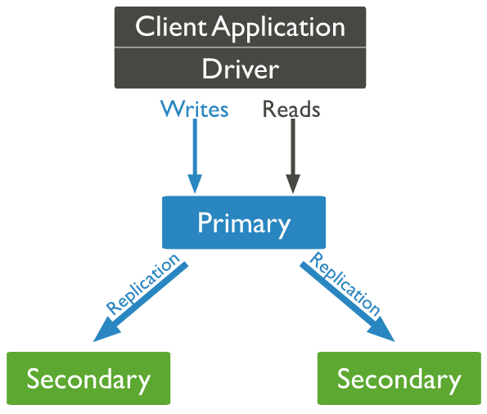

Understanding Replication Architecture
Oplog

